Slide 1
Sports Score Tracker
By: Jason Jacob, Christian Cox, and David Morrison

Slide 2
Problem Statement
The Southeastern Cal Ripken Baseball League based in Lexington, KY, needs to have a way to track their leagues via the World Wide Web. The current system in place calls for manual entry of all leagues and teams into a hand-created spreadsheet. Each year’s schedule is entered along with the outcome of each game. The records of each team must then be manually updated to reflect the scores. The standings of each league must then be manually updated to show which teams are currently ranked first, second, and so on. Additionally, the Southeastern Cal Ripken Baseball League also has several other age groups of leagues that work in conjunction with them. These leagues would also be interested in an online league tracking environment.

Slide 3
Problem Statement, cont.
The Executive Board for the Southeastern Cal Ripken Baseball League would need to be able to add multiple leagues into an online tracking system of some sort. These leagues would need to be able to track multiple teams. Schedules, scores, and standings of these teams would also need to be able to be updated and viewed. The Executive Board would also like the coaches, parents, players, and even the general public to have the ability to view the schedules, scores, and standings for all of the teams in the Southeastern Cal Ripken Baseball league. Additionally, the Executive Board would need to be able to easily add other leagues and teams into the system.

Slide 4
User Requirements
Web-based
Track schedules, real-time scores and standings for user-created sports, leagues, and teams
Ability for users to vote on outcome of games
Users can view and post comments on injuries, scores, or general info
Smart Outcome Prediction System, which takes into account team’s win / loss record

Slide 5
System Requirements Functional Requirements
R1. Register New Account
Guest gives email, password, and first name
Systems ensures validity of email
User sent confirmation of registration
R2. Login / logout
User can login via valid login ID and password
Login confirmation shown
User can logout after successful login
R3. Modify / Reset Password
After successful login, user can change password by giving old password and new password
Change password confirmation shown
User can also reset password using their email address
Temporary password sent to email on file

Slide 6
System Requirements Functional Requirements, cont.
R4. View Games Scores
Guests, registered users, and administrators can view game scores by league(s), sport(s) and/or teams
R5. View Game Schedules
Guests, registered users, and administrators can view game schedules by league(s), sport(s) and/or teams
R6. View comments
Guests, registered users, and administrators can view comments per game
R7. Post comments
After login, registered users and administrators can post comments
R8. User winner prediction
After login, registered users and administrators can vote for their predicted winner per game
R9. View system winner prediction and user winner prediction
Guests, registered users and administrators can view system winner prediction and percentage chart of user winner prediction
System prediction based on team’s win /loss percentages
User winner prediction based on sums of user votes per game

Slide 7
System Requirements Functional Requirements, cont.
R10. Create / modify custom sports
After login, registered users and administrators can create custom sports by providing the sport name.
Custom sport creation confirmation shown
Administrators can delete sports by selecting the sport name
All leagues, teams, games, and comments will be deleted along with sport deletion
Sport deletion confirmation shown
R11. Create / modify custom leagues
After login, registered users and administrators can create custom sports by providing the league name.
Custom league creation confirmation shown
Registered users and administrators can update custom leagues by searching via league name and inputting a new league name.
Custom league update confirmation shown
Registered users and administrators can delete leagues by selecting the league name
All teams, games, and comments will be deleted along with league deletion
League deletion confirmation shown

Slide 8
System Requirements Functional Requirements, cont.
R12. Create / modify custom teams
After login, registered users and administrators can create custom teams by providing the team name, and then by joining the team in a league.
Custom team creation confirmation shown
Registered users and administrators can update custom teams by searching via team name and inputting a new team name, and modifying the league.
Custom team update confirmation shown
Registered users and administrators can delete teams by selecting the team name
All games and comments will be deleted along with team deletion
Team deletion confirmation shown

Slide 9
System Requirements Functional Requirements, cont.
R13. Create / modify custom games
After login, registered users and administrators can create custom games by selecting the two team names, and then by inputting the game details of date, home score, and away score, if known.
Custom game creation confirmation shown
Registered users and administrators can update custom games by viewing the game and updating the date, home score, and/or the away score.
Custom game update confirmation shown
Registered users and administrators can delete games by selecting the game
All comments will be deleted along with game deletion
Game deletion confirmation shown

Slide 10
System Requirements Functional Requirements, cont.
R14. Delete comments
After login, administrators can delete comments per game
R15. Modify users
After login, administrators can modify users by selecting the user and changing the email address, login ID, and/or password.
User creation confirmation shown
Administrators can delete users by selecting the user
All leagues, teams, games, and comments will be deleted along with user deletion
User deletion confirmation shown

Slide 11
System Requirements Non-Functional Requirements, cont.
NR1. Login credentials must meet minimum security specifications
Unique email addresses
Email addresses must be in Fully Qualified Domain Address format
Passwords at least 8 alphanumeric characters that do not contain special characters
NR2. Comments must be filtered before posting
Comments must be 300 characters or less
NR3. The system shall ensure that custom teams can only be modified by creator.
NR4. The system shall ensure that custom sports can only be modified by creator.
NR5. The system shall ensure that custom leagues can only be modified by creator.
NR6. The system shall ensure that custom games can only be modified by creator.

Slide 12
Cost Estimation
Effort Equation
E = 2.4 * (KDSI) ^ 1.05
E = 2.4 * 5 ^ 1.05
E = 13 person months
Schedule Equation
TDEV = 2.5 * (E) ^ 0.38
TDEV = 2.5 * 13 ^ 0.38
TDEV = 7 months
Productivity = 5000 DSI / 13 person months = 385 DSI / PM
Average Staffing = 13 PM / 7 months = 2 people
Actual Average Staffing = 13 PM / 4 months = 3 people

Slide 13
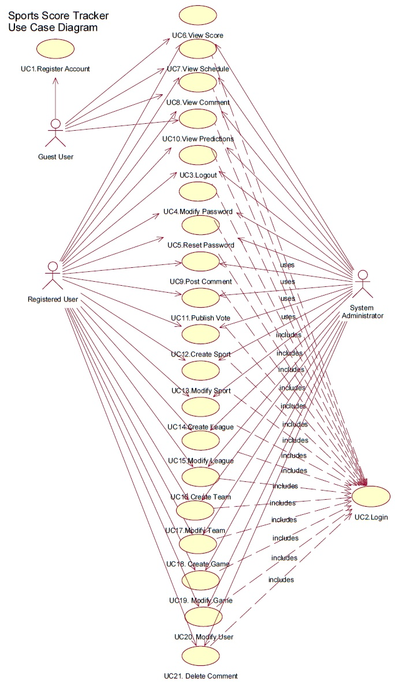

Slide 14
Use Case Validation
 |  | R1 | R2 | R3 | R4 | R5 | R6 | R7 | R8 | R9
 |  | Register New Account | Login/Logout | Modify Password | View Game Scores | View Game Schedules | View Comments | Post Comments | Vote | View Predictions
UC1 | Register Account | X
UC2 | Login user | X | X
UC3 | Logout user |  | X
UC4 | Modify Password |  | X | X
UC5 | Reset password |  |  | X
UC6 | View Score |  |  |  | X
UC7 | View Schedule |  |  |  |  | X
UC8 | View Comment |  |  |  |  |  | X
UC9 | Post Comment |  |  |  |  |  |  | X
UC10 | View Predictions |  |  |  |  |  |  |  |  | X
UC11 | Publish Vote |  | X |  |  |  |  |  | X

Slide 15
Use Case Validation, cont.
 |  | R2 | R10 | R11 | R12 | R13 | R14 | R15
 |  | Login/Logout | Create Sport | Create League | Create Team | Create / Modfiy Game | Delete Comments | Modify Users
UC12 | Create Sport | X | X
UC13 | Modify Sport | X | X
UC14 | Create League | X |  | X
UC15 | Modify League | X |  | X
UC16 | Create Team | X |  |  | X
UC17 | Modify Team | X |  |  | X
UC18 | Create Game | X |  |  |  | X
UC19 | Modify Game | X |  |  |  | X
UC20 | Modify User | X |  |  |  |  |  | X
UC21 | Delete Comment | X |  |  |  |  | X

Slide 16
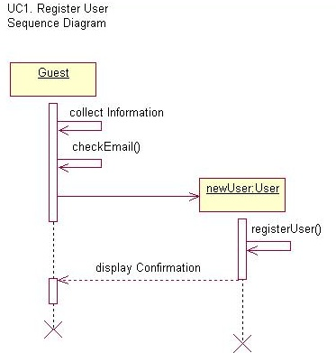

Slide 17
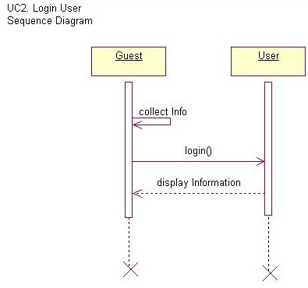

Slide 18
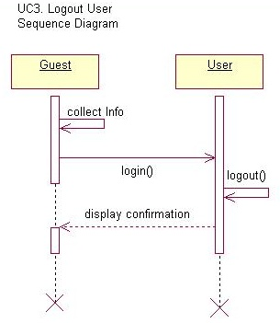

Slide 19
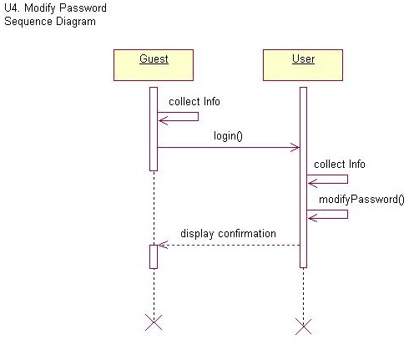

Slide 20
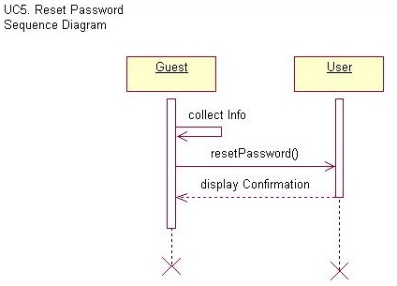

Slide 21
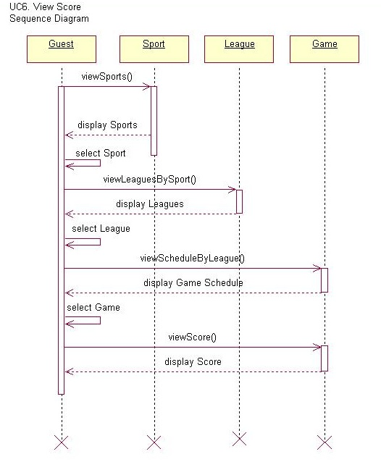

Slide 22
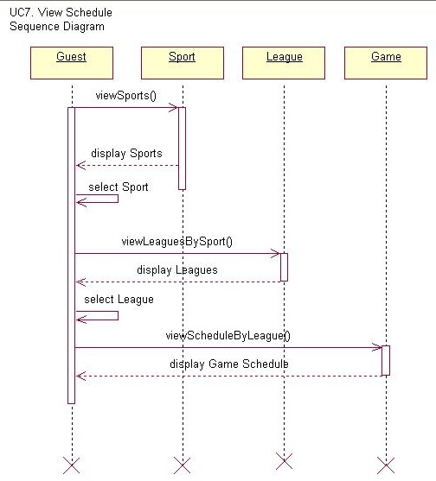

Slide 23
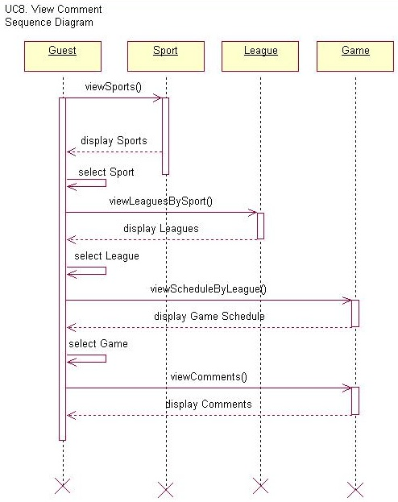

Slide 24
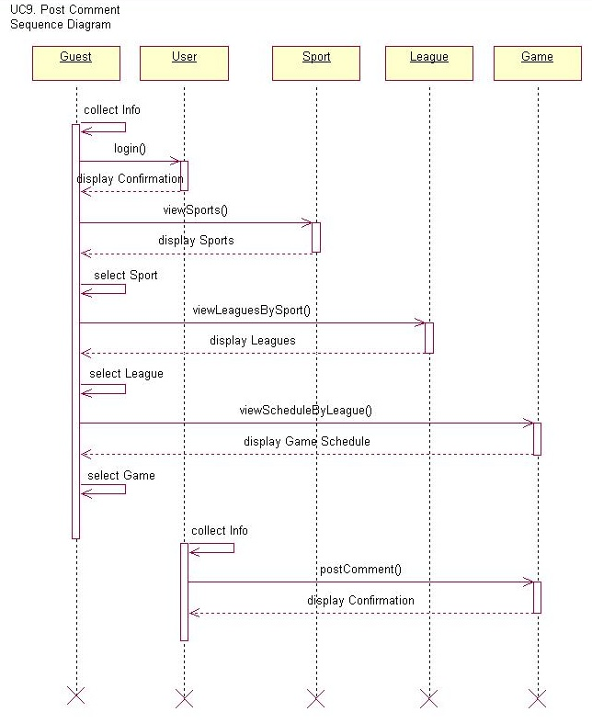

Slide 25
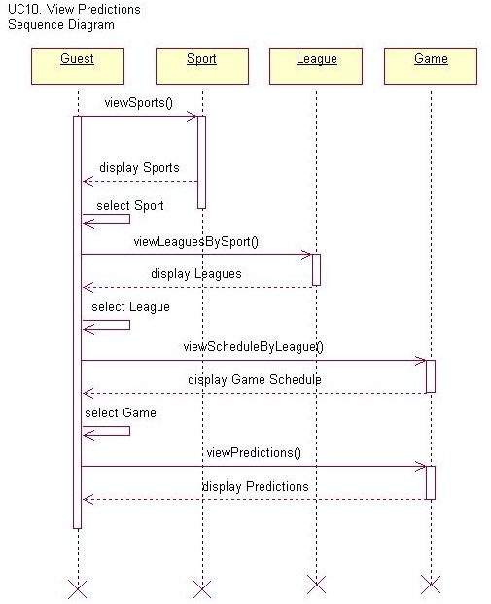

Slide 26
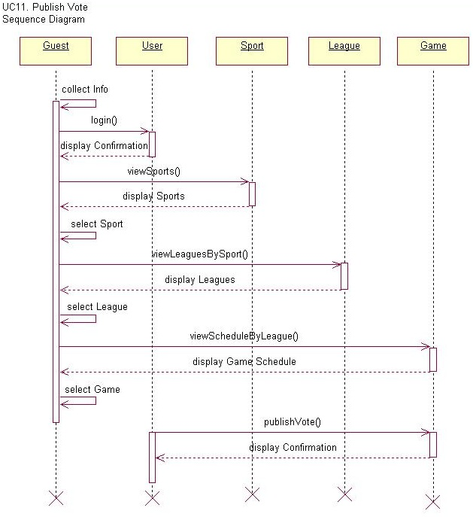

Slide 27
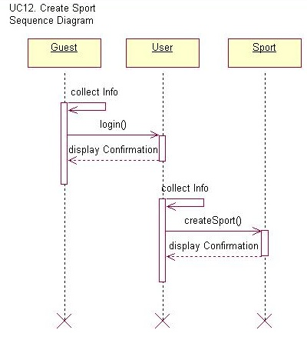

Slide 28
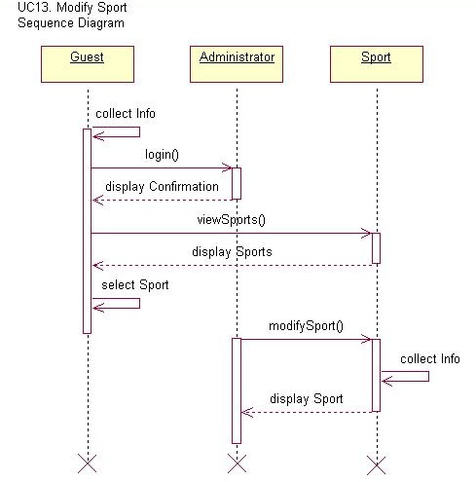

Slide 29
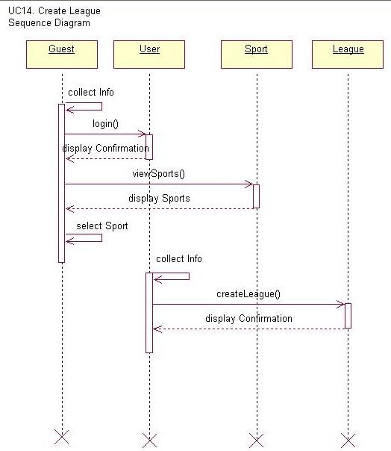

Slide 30
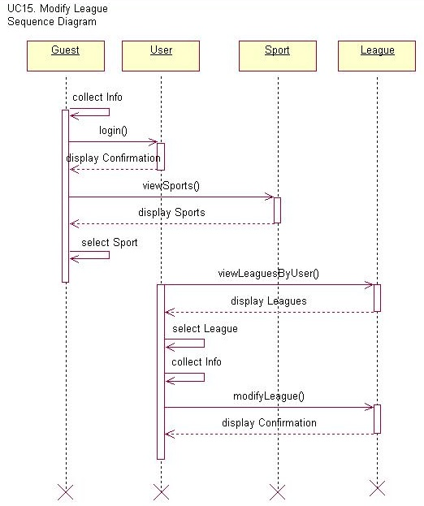

Slide 31
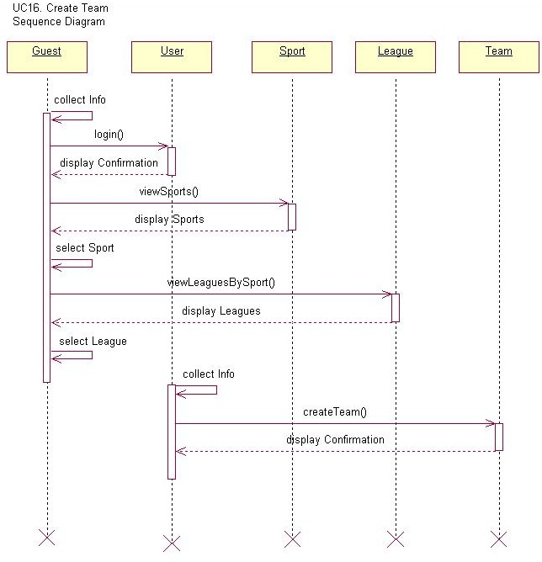

Slide 32
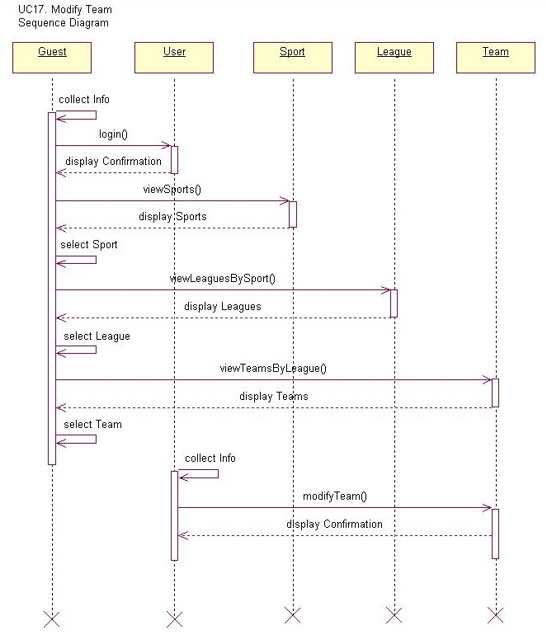

Slide 33
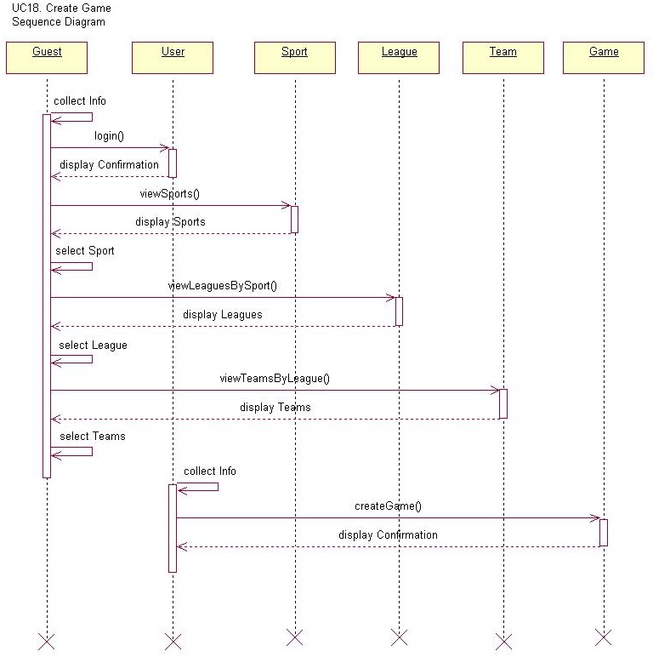

Slide 34
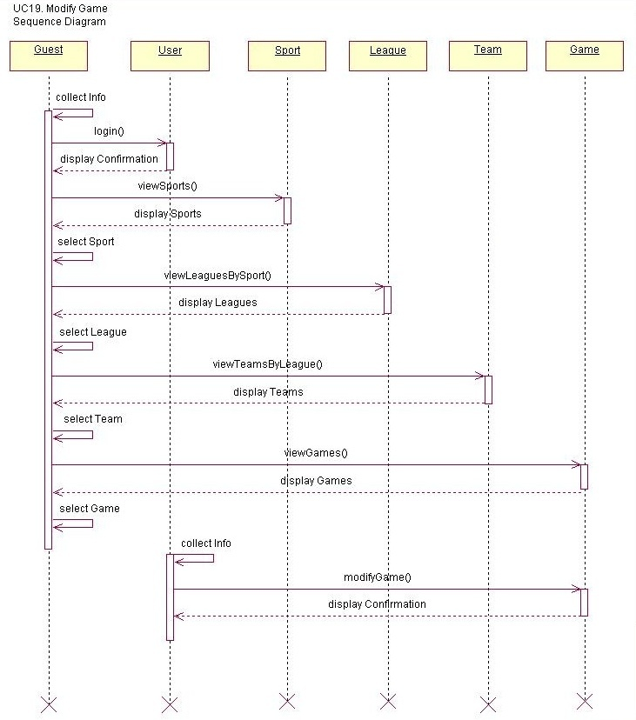

Slide 35
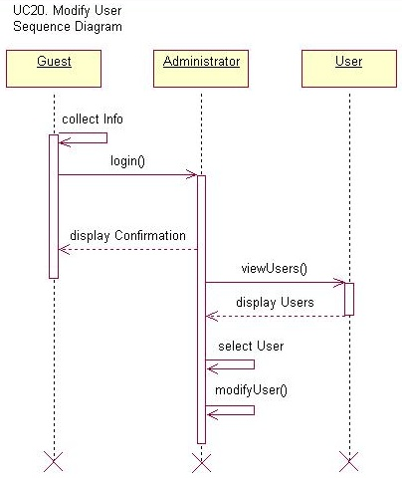

Slide 36
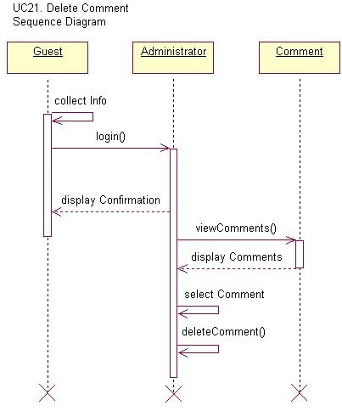

Slide 37
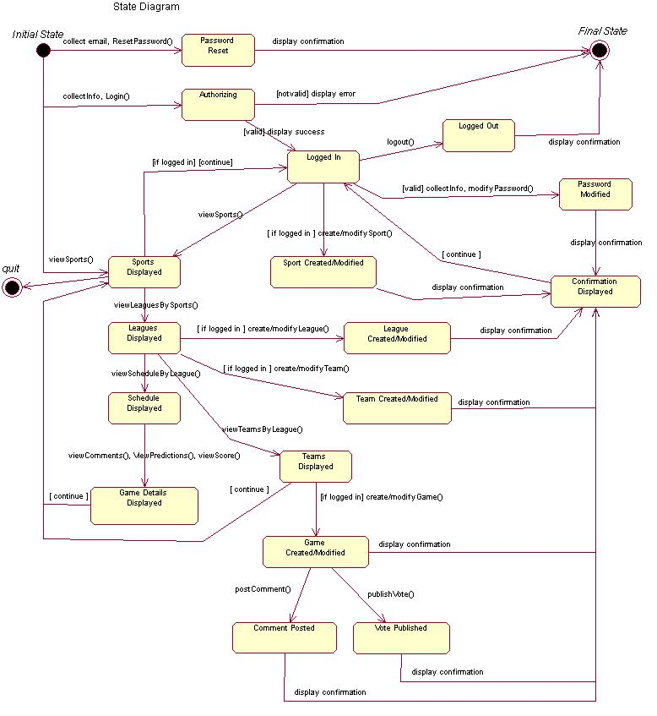

Slide 38
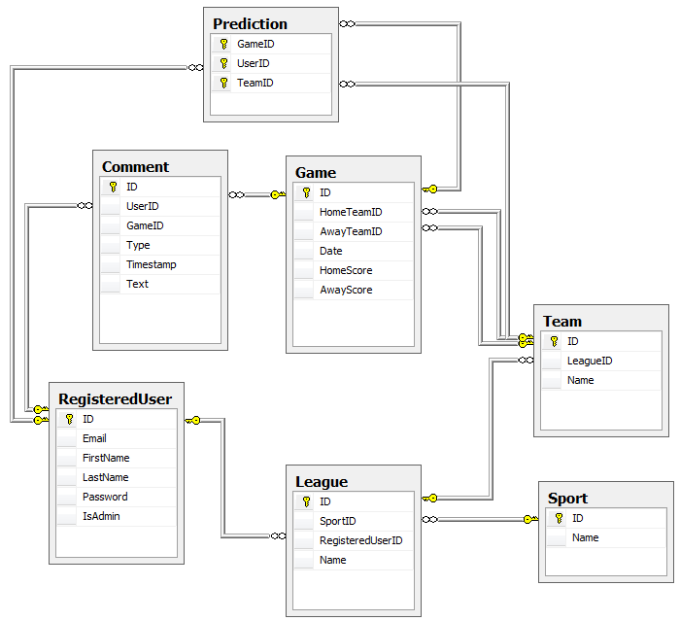

Slide 39
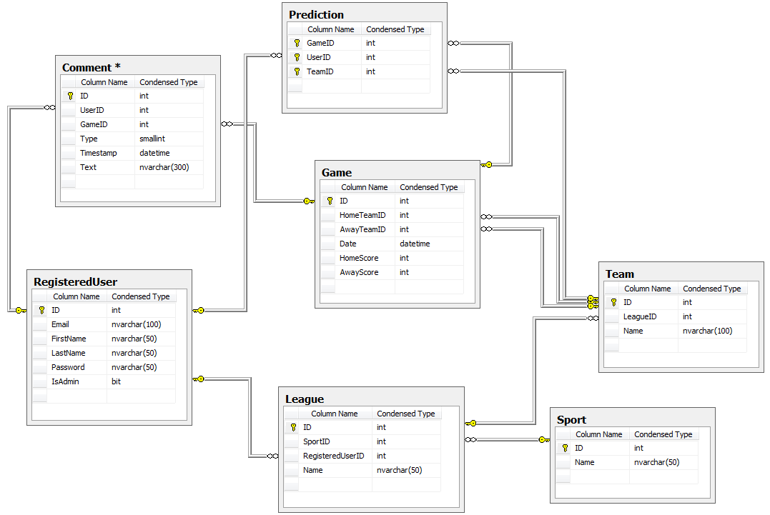

Slide 40
